Slide 1
A Yang Data Model for ACTN VN Operation
draft-lee-teas-actn-vn-yang-03
Young Lee, Huawei
Dhruv Dhody, Huawei
Daniele Ceccarelli, Ericsson
Takuya Miyasaka, KDDI
Peter Park, KT
Bin Yeong Yoon, ETRI

Slide 2
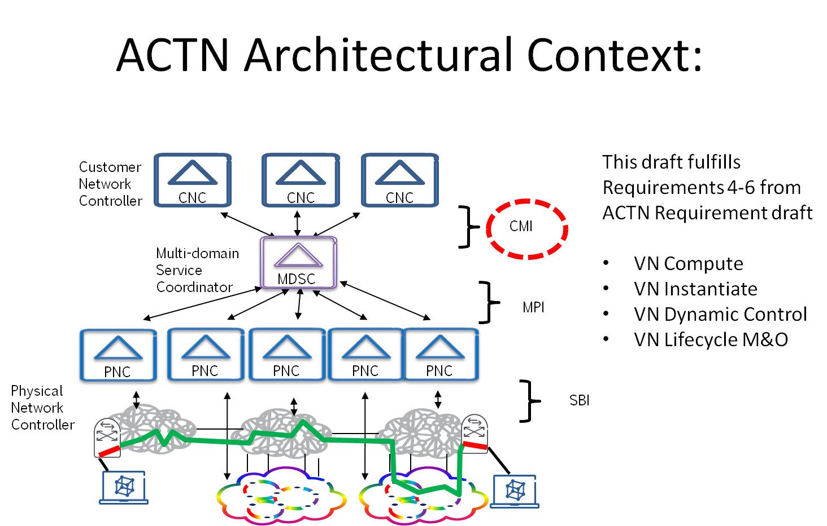
Introduction
A Yang Data Model for ACTN VN operations
This is for CMI i.e. CNC – MDSC Interface
Maps to Customer Service Model
Support for VN views
As set of E2E tunnels (VN-Member)
As abstract topology
Support for Access Point (AP) as per the ACTN framework
MDSC translates and maps the VN request into specific network centric-models
e.g., TE-tunnels [TE-Tunnel], TE-topology [TE-TOPO], etc. and its augmented models
Coordinate the multi-domain network operations with PNCs.

Slide 3
Why?
Virtual Network groups multiple E2E tunnels as a VN.
VN is a unit for concurrency.
TE-tunnel model deals each VN member as a separate entity, so it loses concurrent allocation of TE resources. TE-tunnel model is a sequential provisioning approach.
It is easier for some customers to work on VN level (Network slice) rather than individual TE tunnels.
ACTN VN supports multi-source and multi-destination use-case.
Doing this without this model, would require multiple requests and a sophisticated client to look out for changes.
ACTN VN supports VN compute (pre-instantiation mode) for the whole VN.
There are certain advantages to keep a set of TE-tunnels as one VN unit for applying policy, reroute, protection, restoration, etc. rather than treating each TE-tunnel as individual unit.

Slide 4
Updates in this version
Reference to TE-Topology’s TP for the ACTN’s AP
Bandwidth
src-tp-id? binary
dst-tp-id? binary
network-ref? -> /nw:networks/network/network-id
Reference to the abstract te topology
bandwidth? tet:te-bandwidth
Added Justifications for this Yang Model

Slide 5
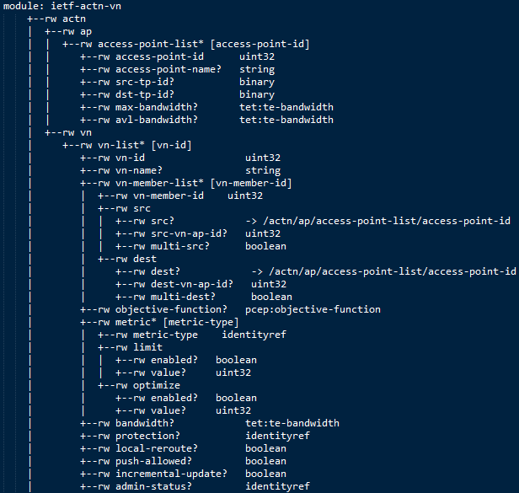
ACTN VN Yang
List of AP
List of VN
VN-member list
Support for multi-src and multi-dest
Objective Functions
Metrics
Limit
Optimizations
Other attributes

Slide 6
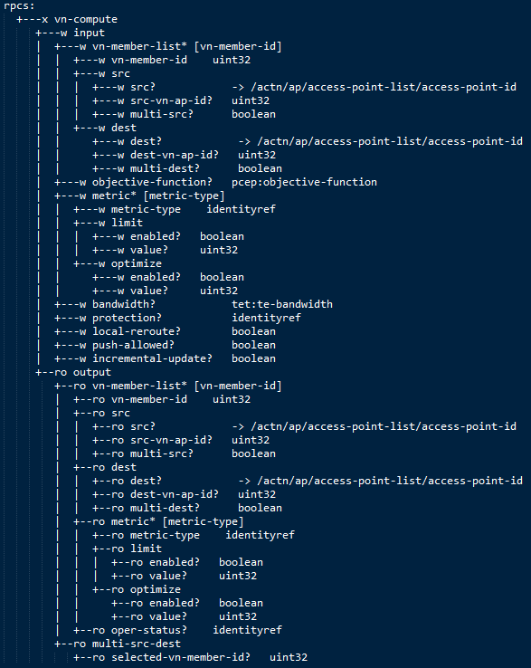
ACTN VN Yang
RPC: VN-Compute
Pre-Instantiation
Input
VN-Members with source, destinations
OF and metric etc
output
VN

Slide 7
NEXT Steps
Continue to enhance the VN Model to meet all requirements of ACTN
VN-Compute RPC output can be enhanced
Keep align with all ACTN documents including [Info-Model]
Comments?
WG adoption!

Slide 8
Thank You!

